Slide 1


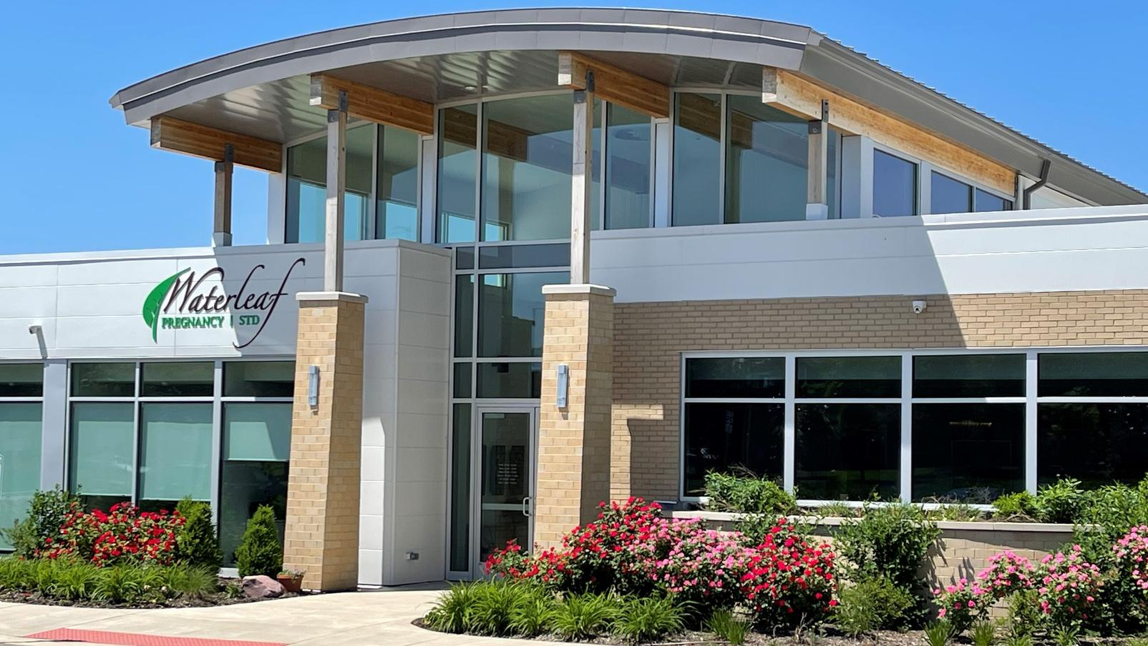

hope starts here

Slide 2

Our mission...
Waterleaf’s mission is to be the chosen destination for women facing an unplanned pregnancy, transforming their fear into confidence, by addressing their physical, spiritual and emotional needs, and equipping them to make healthy life-affirming decisions.

Slide 3

Our History...
Inspired by the Holy Spirit, in 2009 three women set forth to open a free and compassionate alternative to women facing an unplanned pregnancy.
With God’s grace and a small group of volunteers, Waterleaf opened in the fall of 2009 and has served over 10,500 patients!

Slide 4


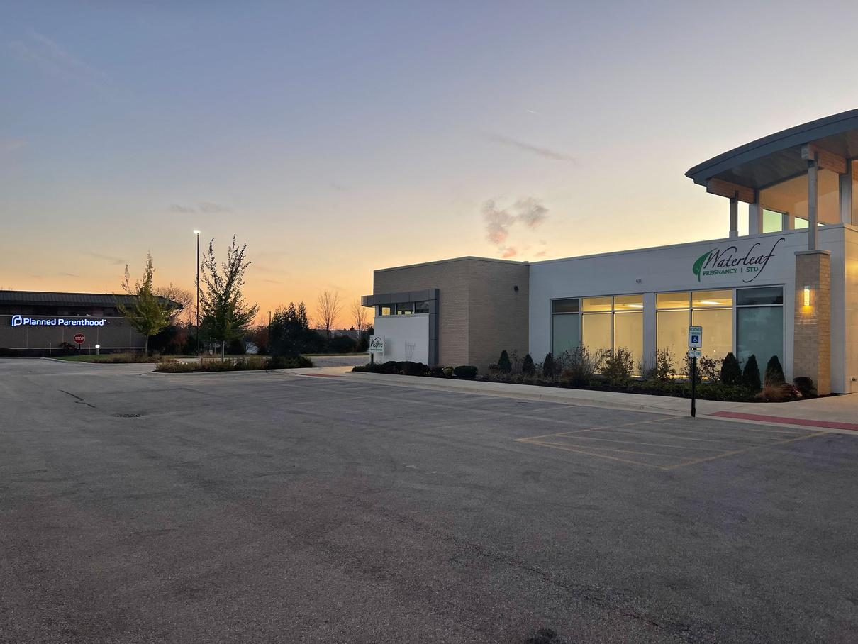

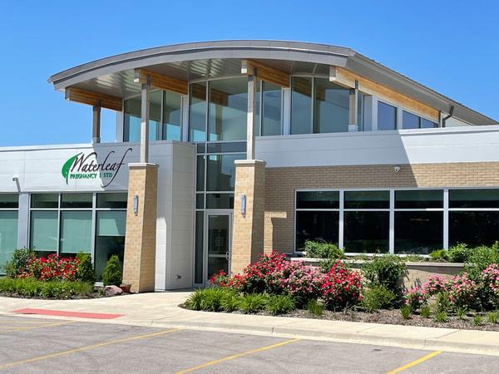
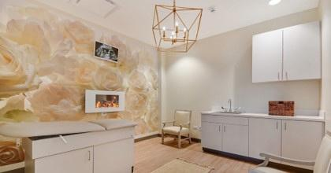
Our History...
In November 2019, we moved into our
current facility adjacent to Planned Parenthood.

Slide 5



  Early Pregnancy Screening
Advocacy and Options Counseling
Pregnancy Test
Limited Ultrasound
Medical Consultation
  Abortion Pill Reversal Services
  Limited STI Testing/Treatment
Chlamydia
Gonorrhea
  Telehealth- online appointments
  Additional services including early pregnancy care and women’s wellness coming in 2025
Our Medical Services

Slide 6
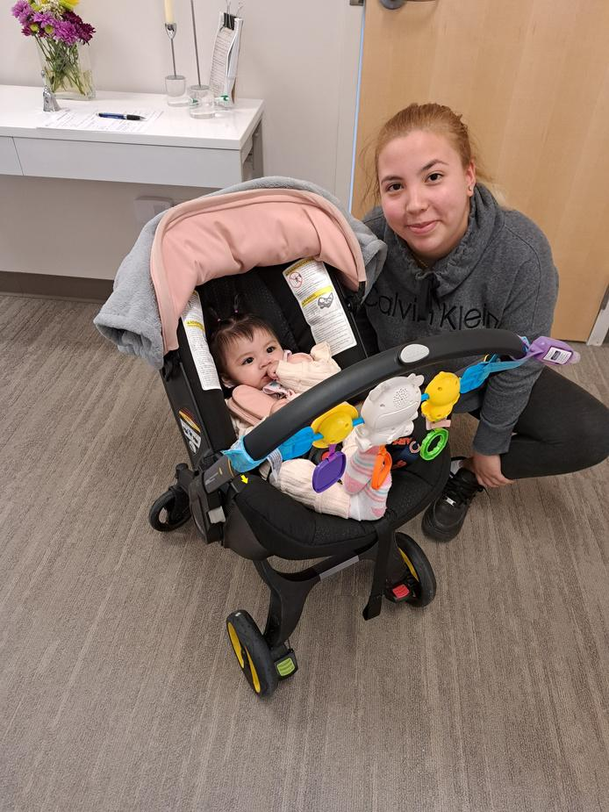
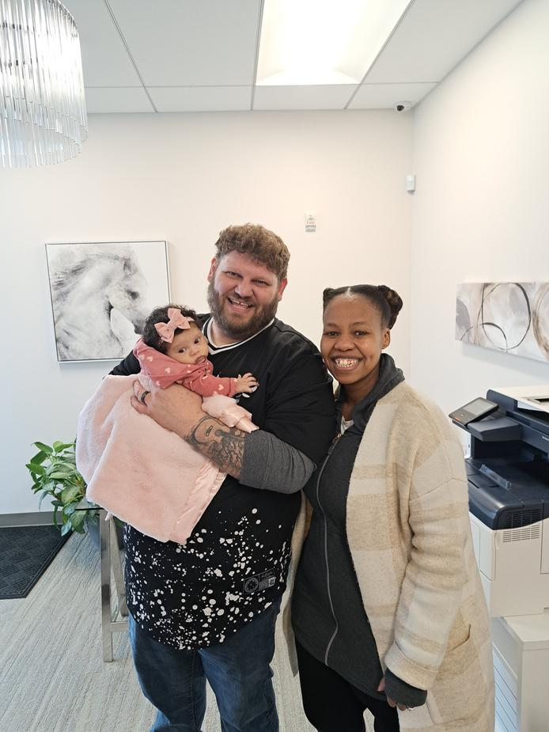
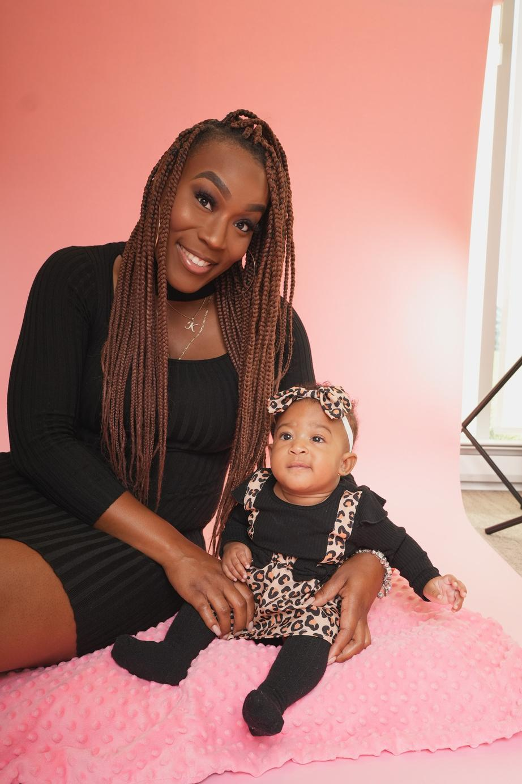
  Education and Resources
Healthy Relations /
Sexual Risk Avoidance
  Body Literacy/Fertility Awareness/
Cycle-Care Education
  Spiritual Formation
  Post Abortive/Pregnancy Loss Counseling
  Resource Assessment/Referral
  Male Mentoring Program
  Earn While You Learn
Our Resource Services

Slide 7
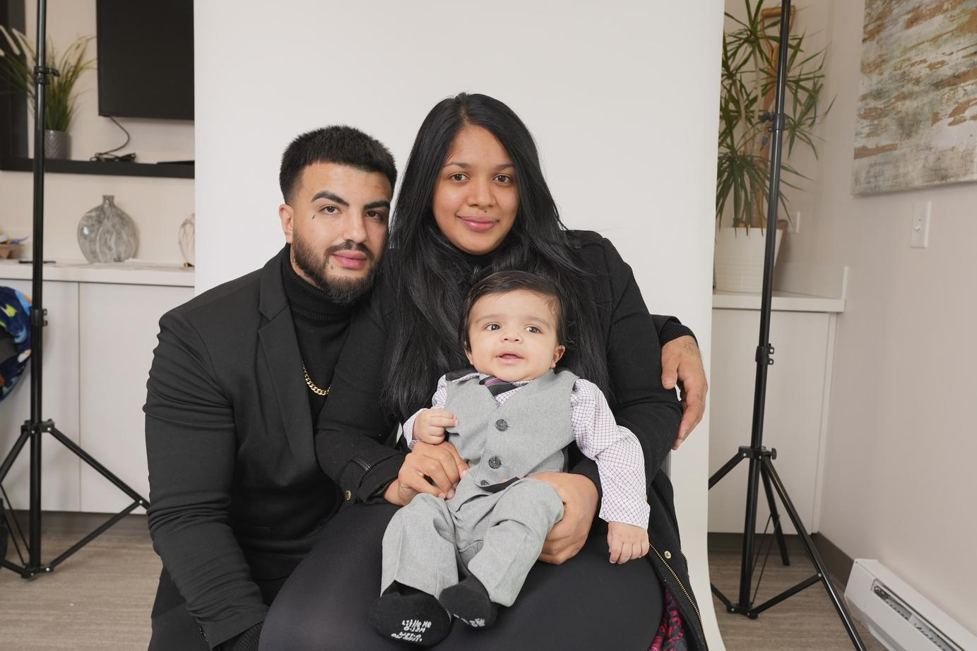
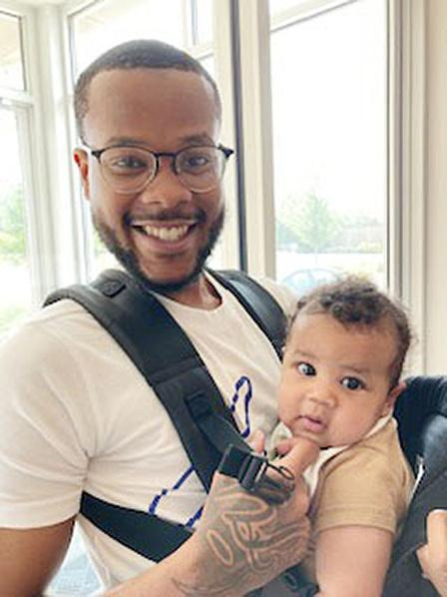

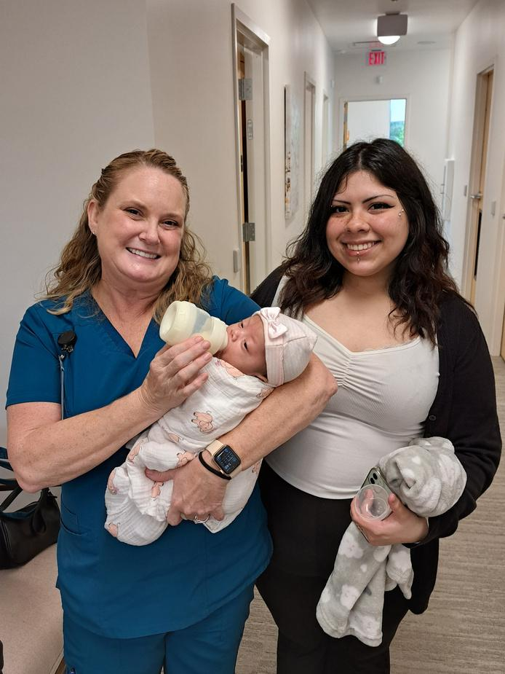
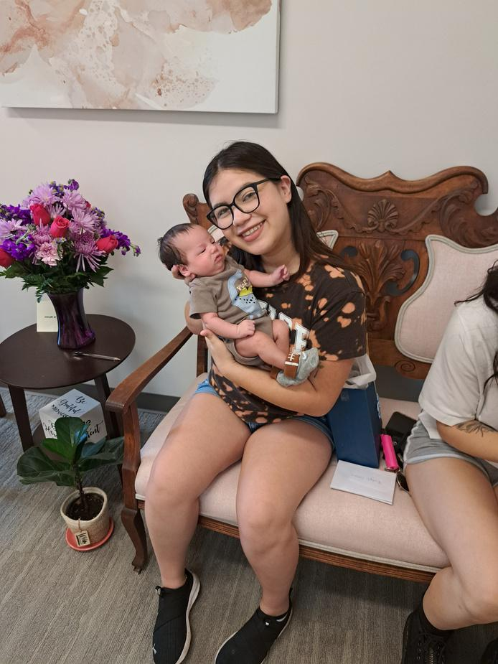
Average Age
<15-1%
15 – 19 11%
20 – 24 33%
25 – 29 27%
30 – 34 16%
>35 10%
Unknown-2%
Our Patients & Clients
Ethnicity
Hispanic 40%
African American 16%
Caucasian 16%
Asian 6%
Other 12%

Slide 8
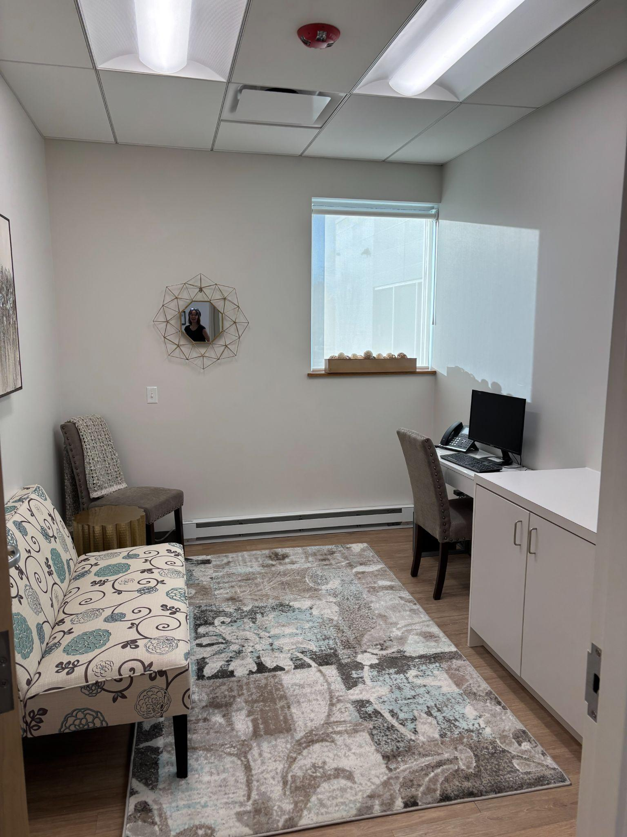
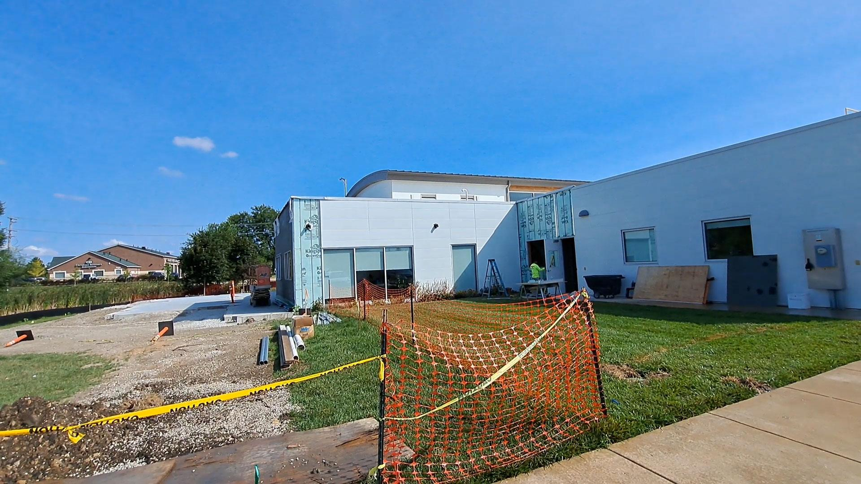
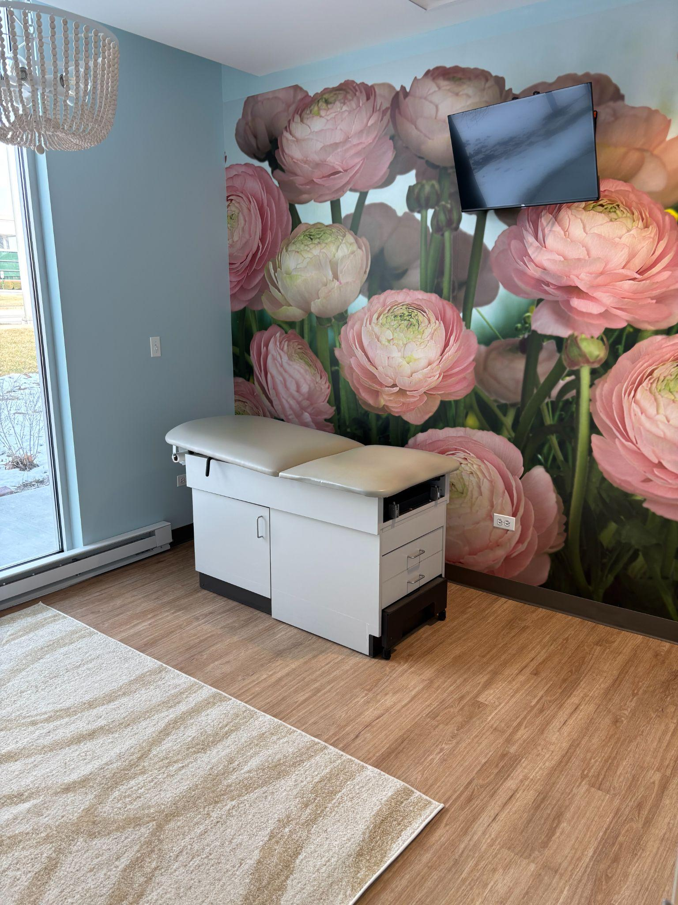
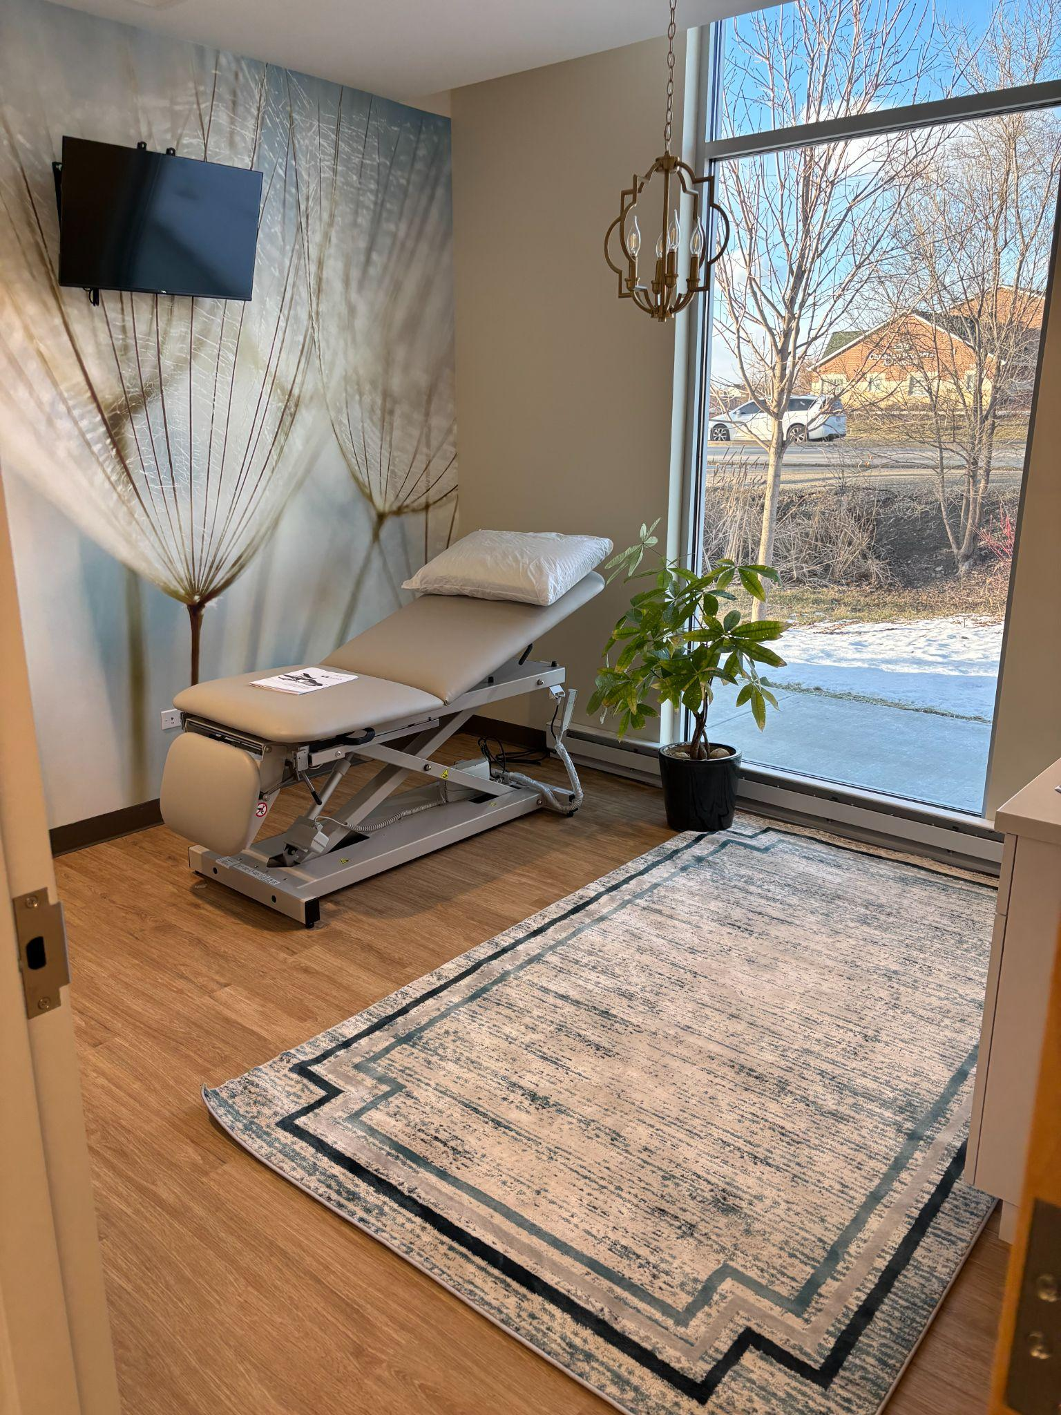
2025
Completed an expansion of our building to better serve our patients and clients

Slide 9


Slide 10
