Slide 1


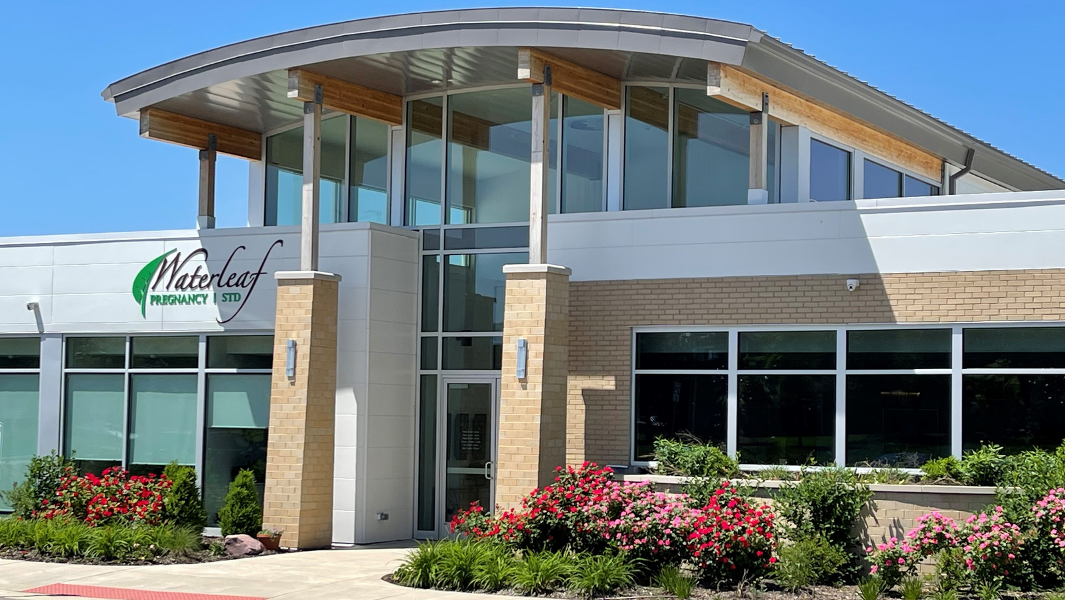

hope starts here

Slide 2
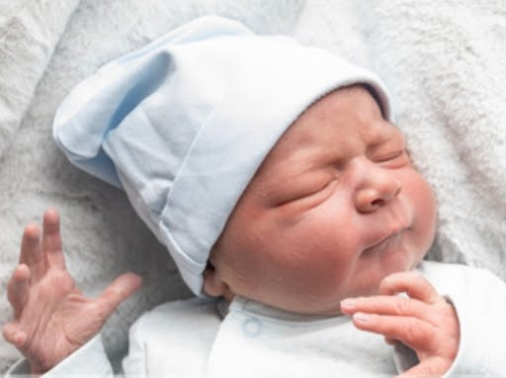
Our mission...
Waterleaf’s mission is to be the chosen destination for women facing an unplanned pregnancy, transforming their fear into confidence, by addressing their physical, spiritual and emotional needs, and equipping them to make healthy life-affirming decisions.

Slide 3
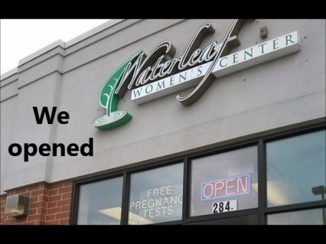
Our History...
Inspired by the Holy Spirit, in 2009 three women set forth to open a free and compassionate alternative to women facing an unplanned pregnancy.
With God’s grace and a small group of volunteers, Waterleaf openind in the fall of 2009 and has served over 8,000 patients!

Slide 4


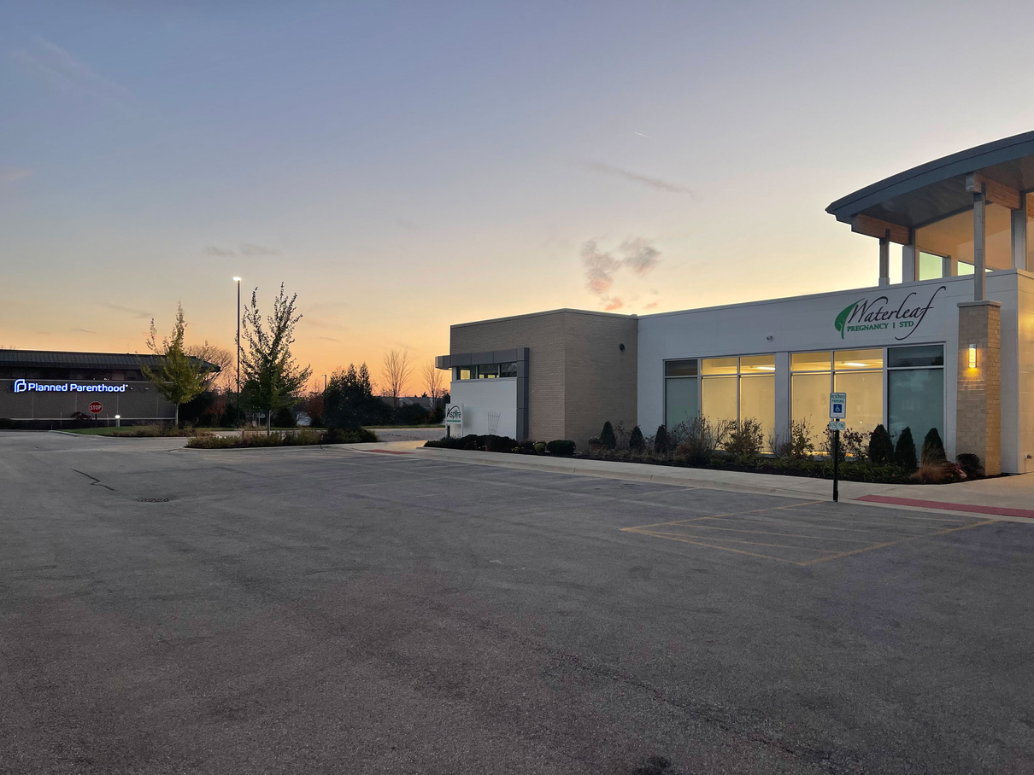
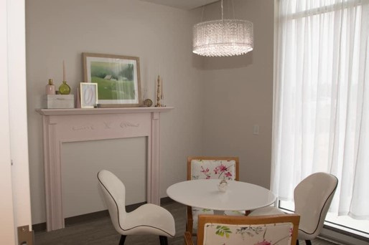
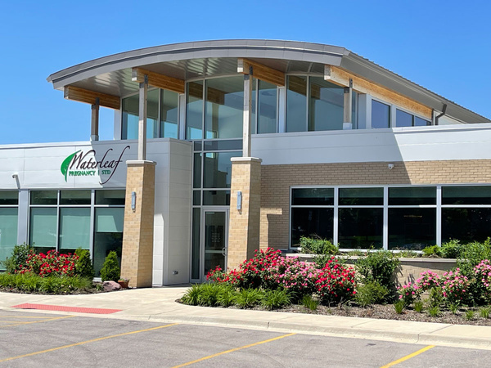
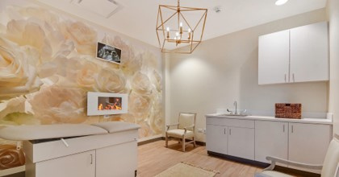
Our History...
In November 2019, we moved into our current 6,000sqft facitlity adjacent to Planned Parenthood.

Slide 5
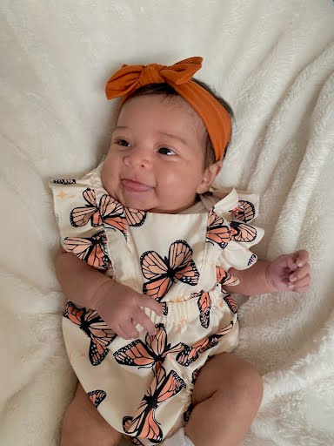
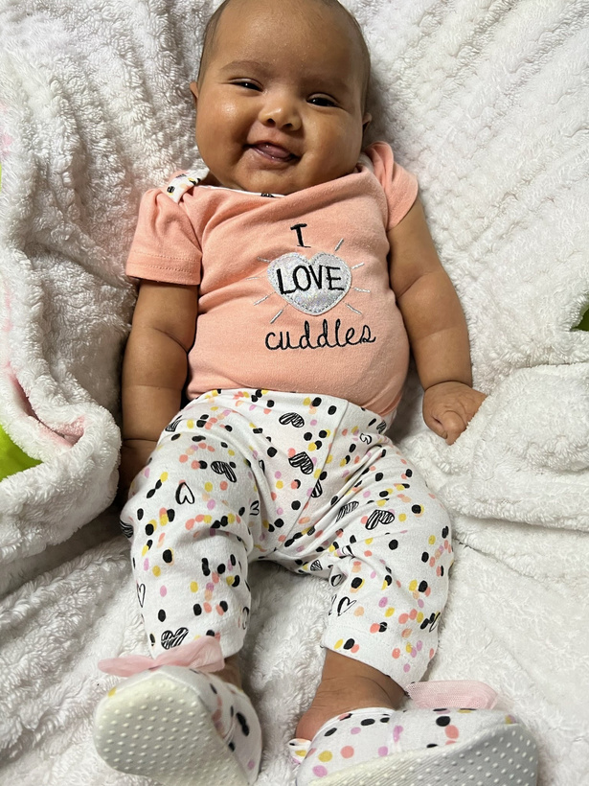
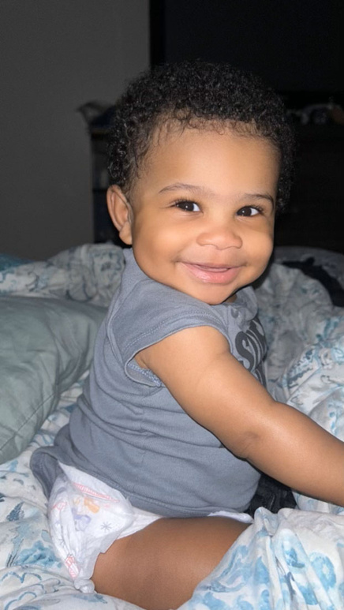
  Early Pregnancy Screening
Advocacy and Options Counseling
Pregnancy Test
Limited Ultrasound
Medical Consultation
  Abortion Pill Reversal Services
  Limited STI Testing/Treatment
Chlamydia
Gonorrhea
  Telehealth- online appointments
Our Medical Services

Slide 6
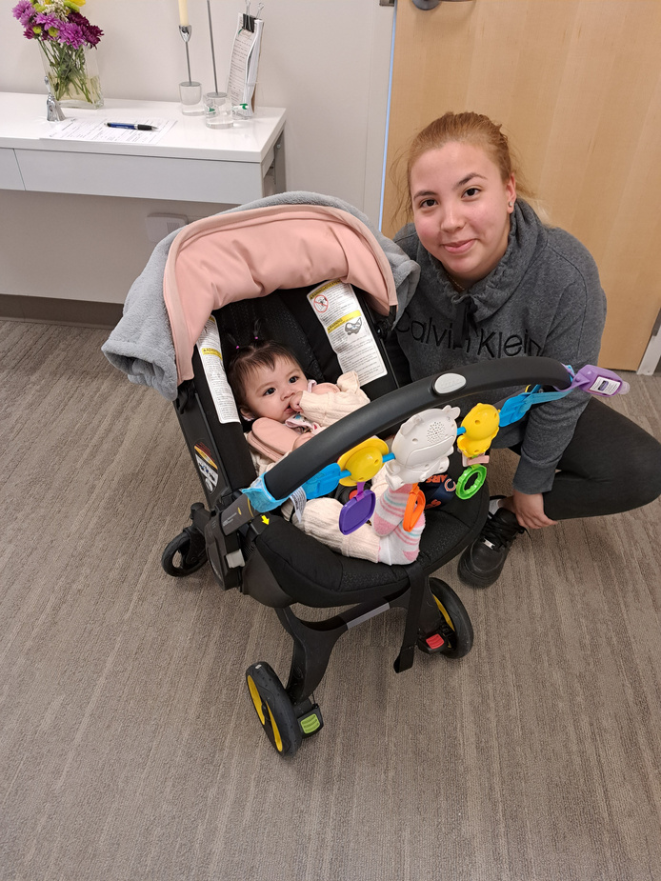
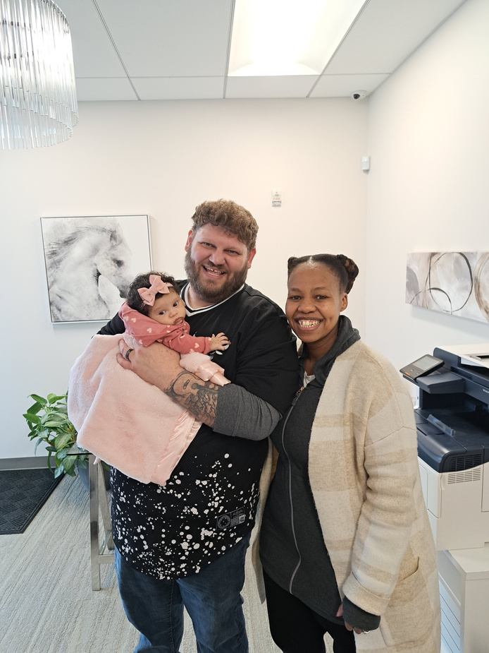
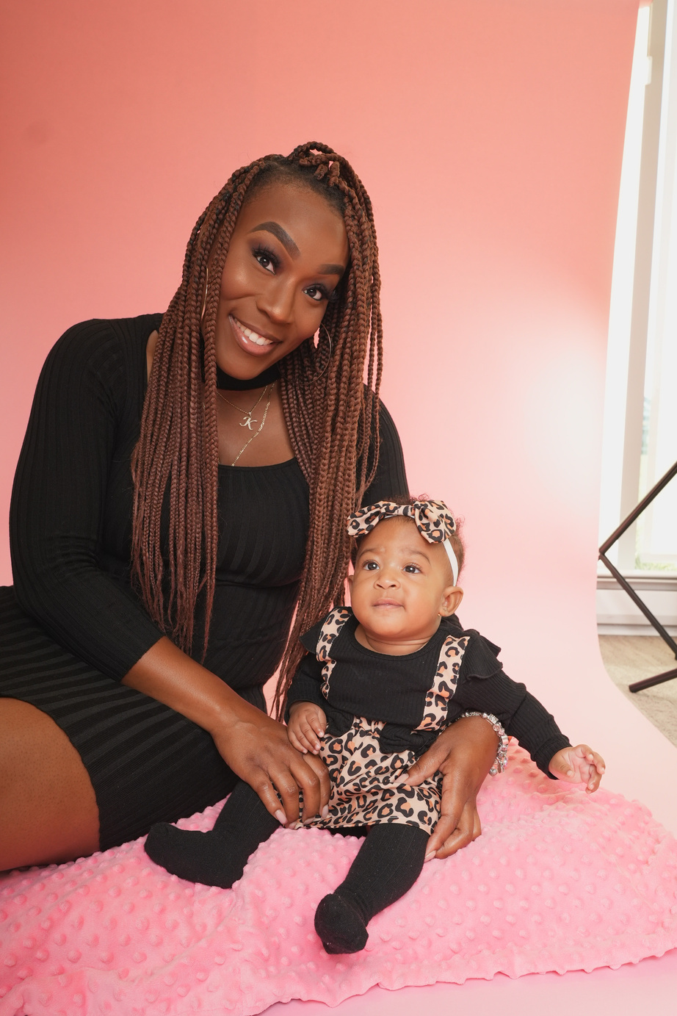
  Education and Resources
Healthy Relations /
Sexual Risk Avoidance
  Birth Control Education
  Spiritual Formation
  Post Abortive/Pregnancy Loss Counseling
  Resource Assessment/Referral
  New Male Mentoring Program
  Earn While You Learn
  Post Abortion Counseling
Our ResourceServices

Slide 7
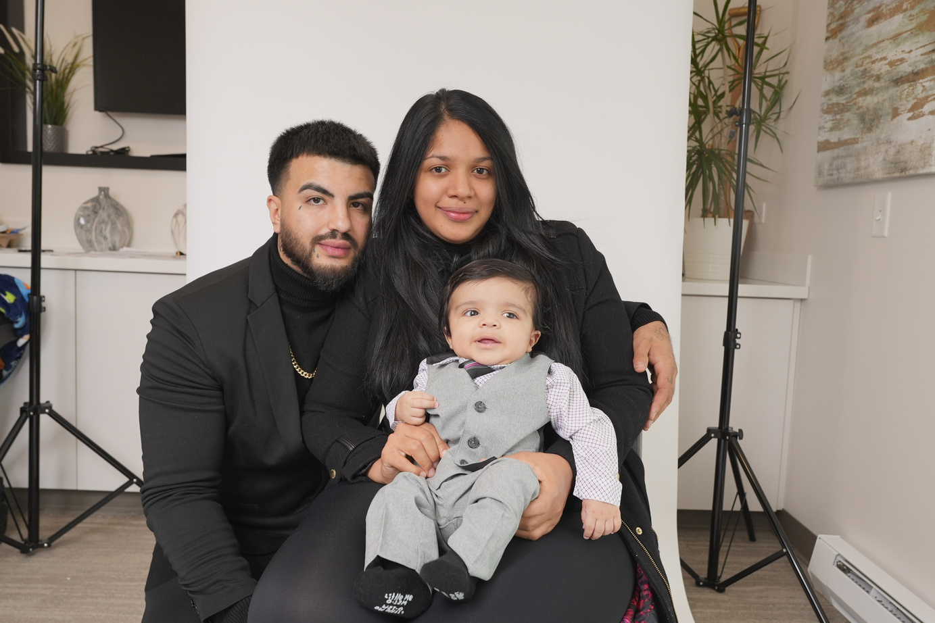
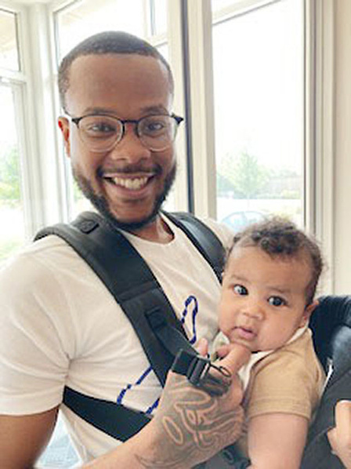
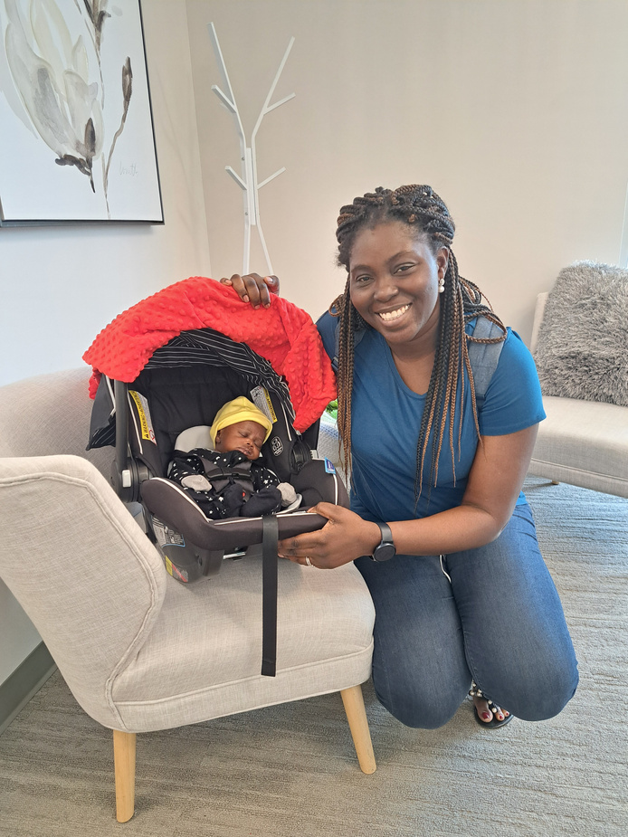
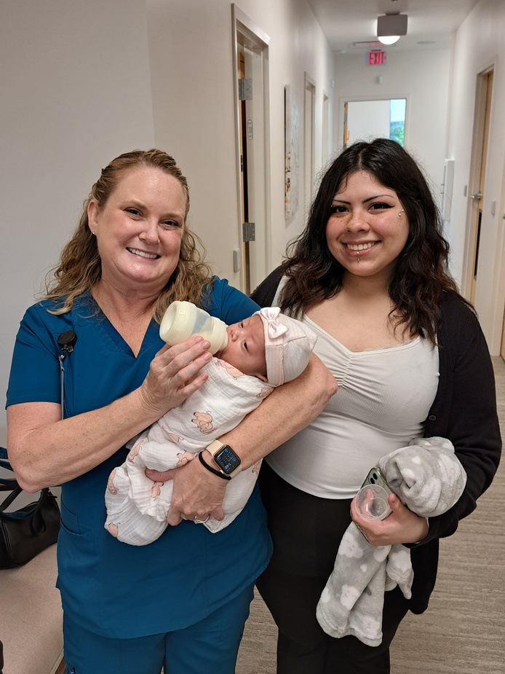
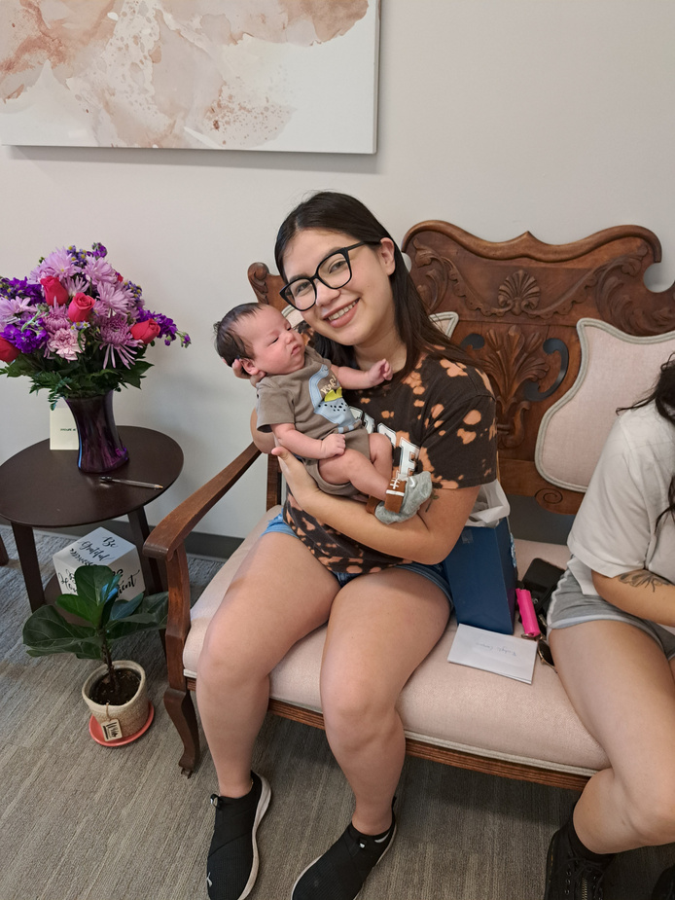
Average Age
15 – 19 19%
20 – 24 39%
25 – 29 23%
30 – 34 10%
>35 9%
Our Patients & Clients
Ethnicity
Hispanic 38%
African American 26%
Caucasian 23%
Asian 4%
Other 9%

Slide 8

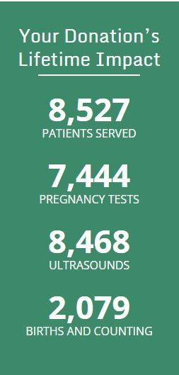
Our Results...14 Years Later

Slide 9
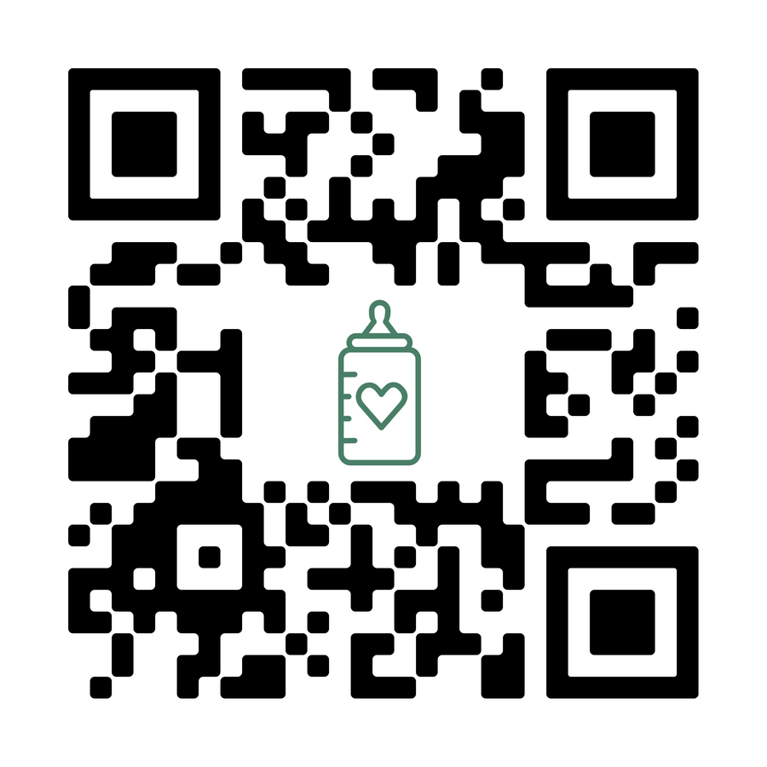
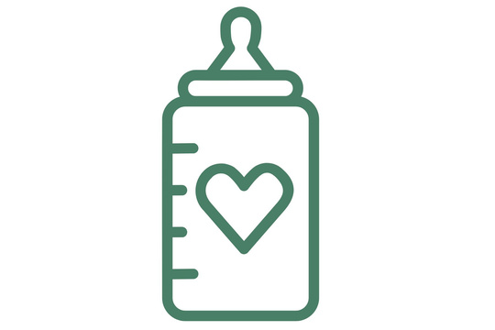

Thank you!
Because of your generosity
We faithfully answer God’s call…Together!
Your Contribution to
Baby Bottles for Life
gives women and men the HOPE and HELP they need to make life affirming decisions
Scan here to give a gift today!

